Slide 1
VPC Endpoints
Private Communication is Better

Slide 2
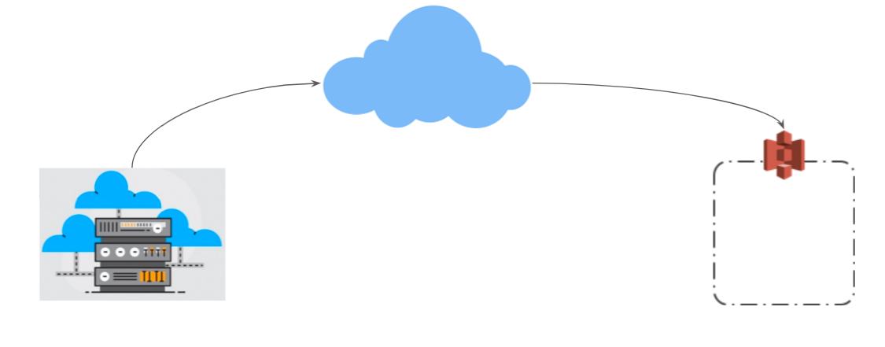
Use-Case: EC2 and S3 Communication
For EC2 instances to be able to access public resources like S3, DynamoDB and others, the traffic needed to be passed via Internet Gateway.
knowledge portal

Slide 3








Architectural Perspective
EC2 traffic towards S3 is routed to Internet Gateway
Internet
AWS Cloud
Public Subnet
EC2
Internet Gateway
Amazon S3
S3 Bucket
knowledge portal

Slide 4


Challenge with Private Workloads
Internet
Public Subnet
EC2
Internet Gateway
Amazon S3
S3 Bucket
Private Subnet
No Internet Route
EC2

Slide 5
Downsides of Using Public Internet
Data transfer cost of AWS
2 . Higher Latency
3. Can bottleneck your internet gateway.
4. Security
knowledge portal

Slide 6

Overview of VPC Endpoints
VPC Endpoints allows us to connect VPC to another AWS services OR other supported services over AWS private network.
AWS Cloud
Private Subnet
EC2
VPC Endpoint
Amazon S3
S3 Bucket
knowledge portal

Slide 7
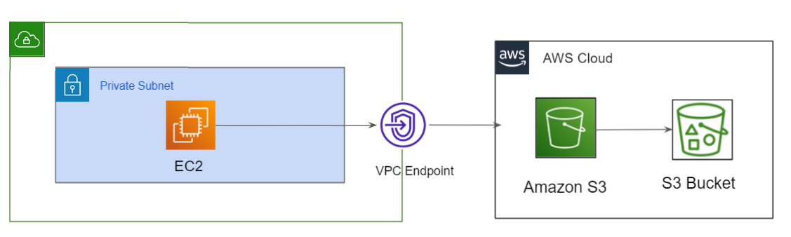
Overview of VPC Endpoints
VPC Endpoints allows us to connect VPC to another AWS services OR other supported services over AWS network.
knowledge portal

Slide 8
Revising Important Pointers
AWS PrivateLink is a technology that enables you to privately access services by using private IP addresses.
To use AWS PrivateLink, you can create a VPC endpoint for a service in your VPC.
VPC Endpoint allows us to connect VPC to another AWS services over AWS network.
Traffic between your VPC and the other service does not leave the Amazon network.
knowledge portal

Slide 9
Gateway VPC Endpoints
Understanding Types

Slide 10
VPC Endpoints Type
There are three primary types of VPC Endpoints available.
VPC Endpoints
Gateway Endpoints
Interface Endpoints
Gateway Load balancer Endpoints
knowledge portal

Slide 11
Gateway VPC Endpoints
We specify the Gateway Endpoint as a route table target that is destined for supported AWS services.
Destination | Target
172.31.0.0/16 | local
pl-1a2b3c4d | vpce-11bb22cc
54.231.0.0/17

Slide 12
Supported Services
A gateway endpoint is for the following supported AWS services:
Amazon S3
DynamoDB
knowledge portal

Slide 13
Today’s Architecture
Internet
Public Subnet
EC2
Internet Gateway
Amazon S3
S3 Bucket
Private Subnet
No Internet Route
EC2

Slide 14
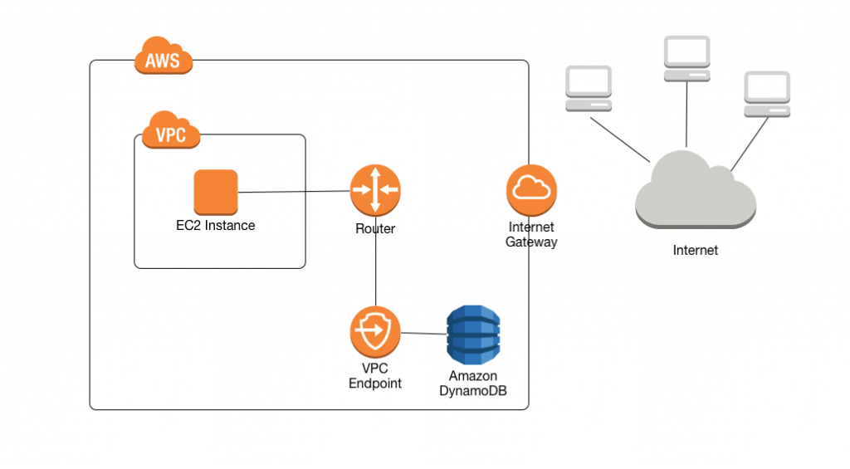
Downsides of Gateway Endpoints - 1
In Gateway endpoints approach, the VPC endpoint was created outside your VPC and traffic was routed via route table.
Thus, it is not possible to use it directly from VPN’s or Direct connects and variou others.
knowledge portal

Slide 15
Downsides of Gateway Endpoints - 2
Endpoints are supported within the same Region only. You cannot create an endpoint between a VPC and a service in a different Region.
Endpoints support IPv4 traffic only.
You must turn on DNS resolution in your VPC, or if you're using your own DNS server, ensure that DNS requests to the required service (such as Amazon S3) are resolved correctly to the IP addresses maintained by AWS.
knowledge portal

Slide 16
Interface Endpoints
New Generation Endpoint

Slide 17
Downsides of Gateway Endpoints - 1
In Gateway endpoints approach, the VPC endpoint was created outside your VPC and traffic was routed via route table.
Thus, it is not possible to use it directly from VPN’s or Direct connects and variou others.
knowledge portal

Slide 18


Interface Endpoints
An interface endpoint is an elastic network interface with a private IP address from the IP address range of your subnet.
It serves as an entry point for traffic destined to a supported AWS service or a VPC endpoint service.
Private Subnet
Amazon S3
EC2
Interface VPC Endpoint
Amazon SQS

Slide 19
Benefits of Interface Endpoint
Interface endpoints enable the use of security groups to restrict access to the endpoint.
VPN’s and Direct Connect based connections are supported.
Interface endpoints supports lot of services unlike Gateway endpoints.
knowledge portal

Slide 20
VPC Endpoint Services
More Use-Cases Supported

Slide 21
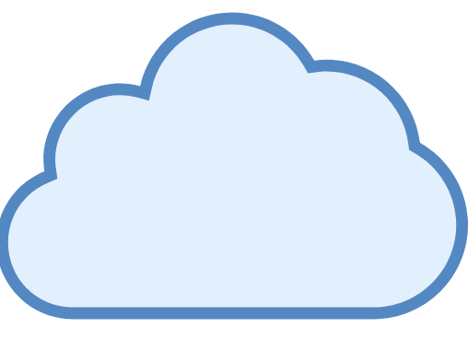

Sample Use-Case
There are many service providers like DataDog, New Relic for which we need to upload our server/application metrics through Internet.
Send Metrics
Receive Metrics
Internet
Send Data - Internal Network
Consumers
Service Providers
knowledge portal

Slide 22
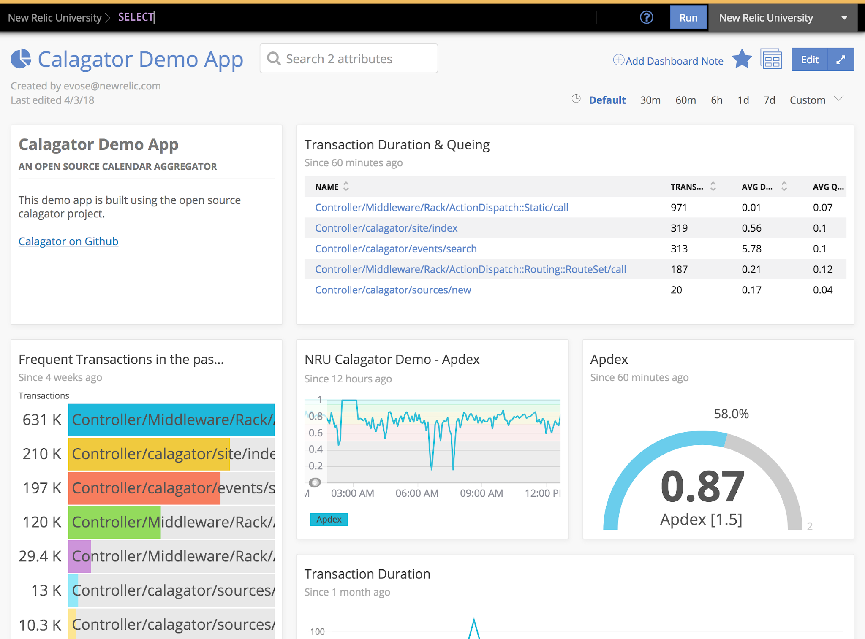
Dashboards using Metrics Collected
knowledge portal

Slide 23
Possible Approach - VPC Peering
VPC Peering Approach will have multiple challenges related to CIDR overlap between clients.
Consumer 1
172.31.0.0/16
Service Providers
10.77.0.0/16
Consumers 2
172.31.0.0/16

Slide 24
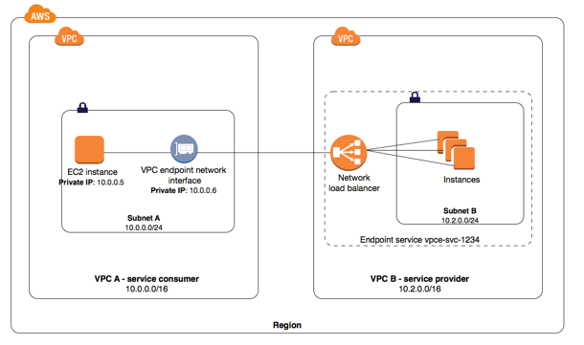
Service VPC Endpoints
You can create your own application in your VPC and configure it as an AWS PrivateLink-powered service (referred to as an endpoint service)
knowledge portal

Slide 25
Direct Connect
Let’s Route Centrally

Slide 26


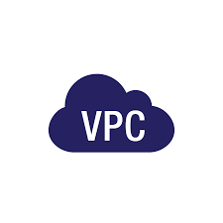
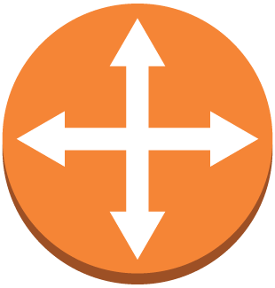
Customer to VPC
knowledge portal

Slide 27

Packets travels via Hops

Slide 28

Challenges
Internet is a good option if amount of traffic is within a certain limit.
There are always latencies which can also be involved.
Many of the organization have hybrid architecture : DataCenter + AWS
In such cases, latency can cause major challenges for the application

Slide 29
Introducing DX
In order to solve this challenge, AWS introduced Direct Connect.
AWS Direct connect let’s customer establish a dedicated direct network connection between the client’s network and one of the direct connect locations.

Slide 30
Benefits of DX
Having direct connection between customer’s datacenter to AWS, brings tremendous amount of benefits, some of them includes:
i) Consistent Network Performance:
ii) Reduces our bandwidth costs
iii) Private connectivity to our AWS VPC

Slide 31
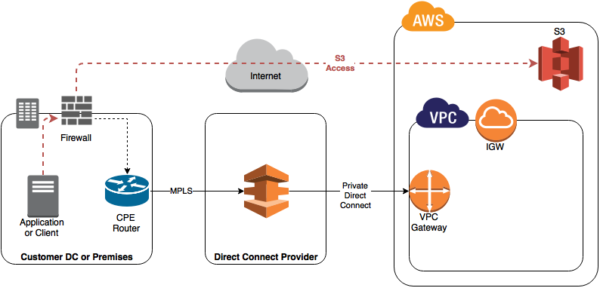
Architecture of DX
knowledge portal

Slide 32
Transit Gateways
Challenges and Structure

Slide 33

Overview of Transit Gateways
A transit gateway is a network transit hub that you can use to interconnect your virtual private clouds (VPC) and on-premises networks.
VPC 1
VPC N
Transit Gateways
knowledge portal

Slide 34
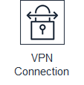
VPC 1
VPC N
Transit Gateways
On-Premise DataCenter
knowledge portal

Slide 35
Transit Gateway Concepts
Attachment
We can attach a VPC or VPN connection to a transit gateway.
2) Transit gateway Route table
A route table includes dynamic and static routes that decide the next hop based on the destination IP address of the packet.
Attachment can be associated with a single route table.
knowledge portal

Slide 36
Transit Gateway Concepts
3) Association
Each attachment is associated with exactly one route table.
4) Route Propagation
A VPC or VPN connection can dynamically propagate routes to a transit gateway route table.
With a VPC, you must create static routes to send traffic to the transit gateway.
With a VPN connection, routes are propagated from the transit gateway to your on-premises router using Border Gateway Protocol (BGP).
knowledge portal

Slide 37




Logging Account Structure
Logs should be stored at centralized place where they can be monitored and analyzed in regular basis.
CloudTrail
Account A
Central Account
Config
Account B
knowledge portal

Slide 38


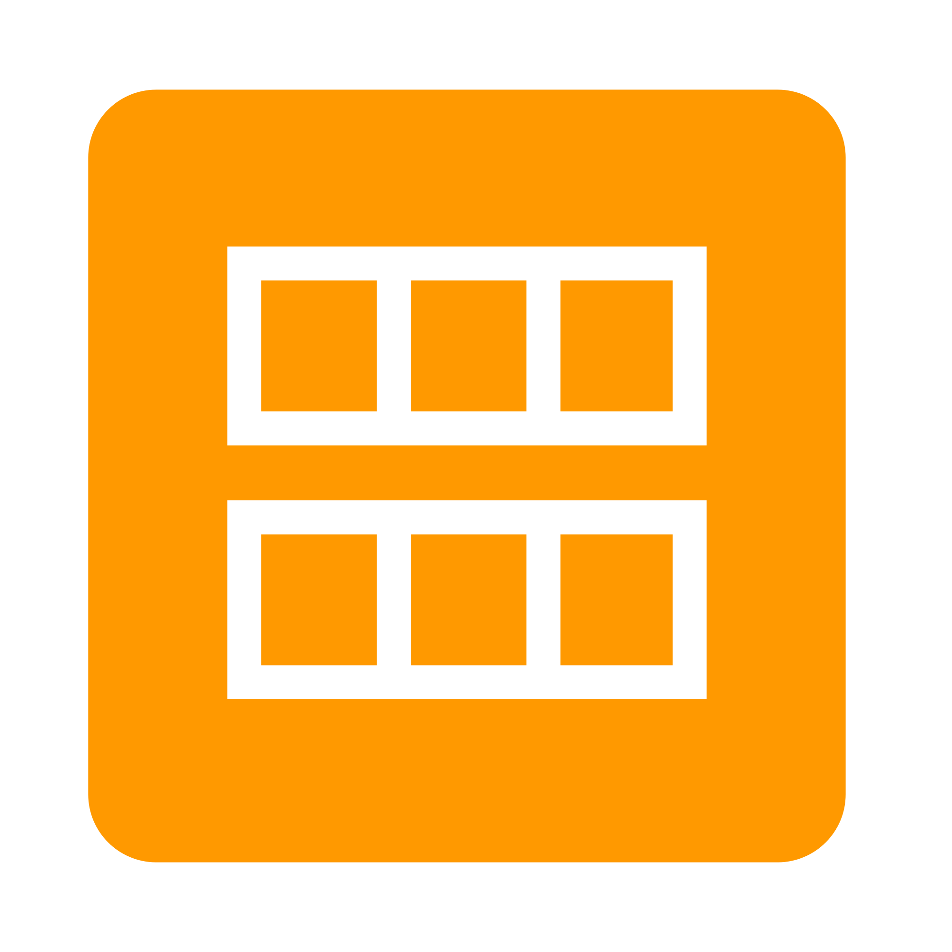
Publishing Account Architecture
This account structure can be beneficial for customers who want to centrally manage pre approved server images and AWS CloudFormation templates across a company.
Service Catalog
Account A
EC2 AMI
Account B
knowledge portal

Slide 39
Billing Structure
You can use the consolidated billing feature in AWS Organizations to consolidate billing and payment for multiple AWS accounts accounts
One Bill + Easy Tracking + Combined Usage + No Extra Fee
Master Account
Account A
Account B
knowledge portal

Slide 40
Placement Groups
Time to go fast

Slide 41

Placement Groups
Placement group are recommended for applications that require low latency, high network throughput.
Placement groups can also be used to influence placement of a group of EC2 instances.
knowledge portal

Slide 42


Small Road vs Highway
knowledge portal

Slide 43
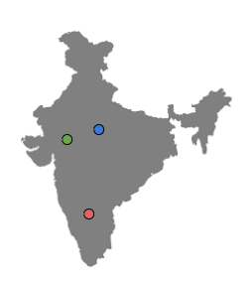


Let’s understand GUI way
Placement Group
knowledge portal

Slide 44
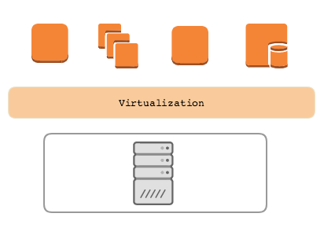
Point 2 - Influencing Placement of EC2
A single server can run multiple virtual machines.
This can lead to issues if you are running a cluster of servers.
Example:
Medium Corp is running a MySQL cluster consisting of two servers in single AZ. In the background, both the EC2 are part of the same underlying host.
knowledge portal

Slide 45


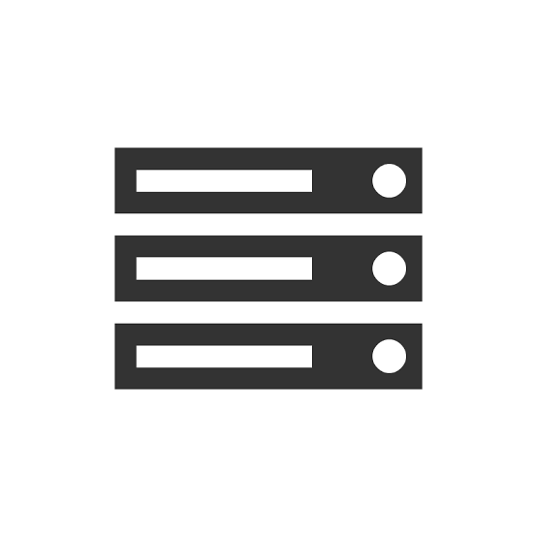
Example Use-Case
Medium Corp is running a MySQL cluster consisting of two servers in single AZ. The server are of type m4.large.
In the background, both the EC2 are part of the same underlying host.
Virtualization
knowledge portal

Slide 46
Solution - Placement Group
With placement group, we can explicitly specify that two EC2 instance should not be part of the same server (same rack of servers)
Virtualization
Virtualization
knowledge portal

Slide 47
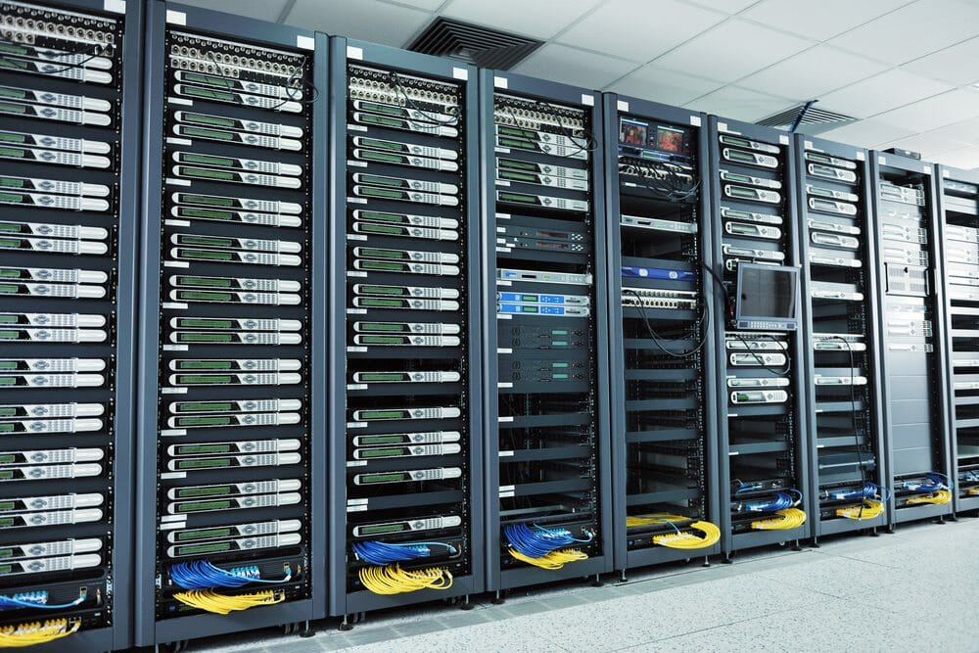
Racks in Data Center
knowledge portal

Slide 48
Types of Placement Groups
There are three types of placement groups available:
Sr No | Type | Description
1 | Cluster | Packs instances close to each other in an Availability Zone.
2 | Partition | Spreads instances in logical partition such that group of instances in one partition do not share underlying hardware.
3 | Spread | Strictly places group of instances across distinct hardware to reduce failures.
knowledge portal

Slide 49
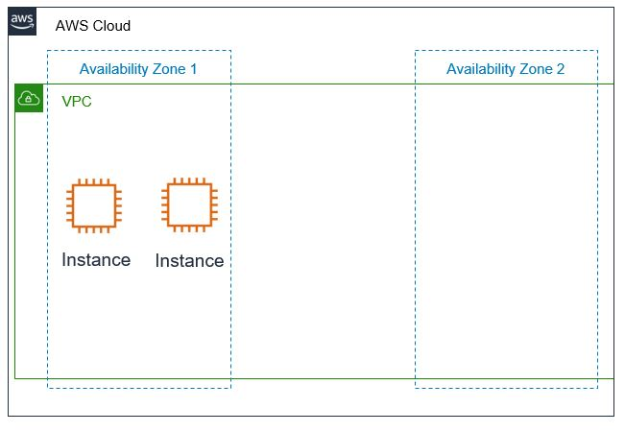
Cluster Placement Groups
Logical grouping of instances within a single Availability Zone.
Intended for applications that require low network latency and high network throughput.
knowledge portal

Slide 50
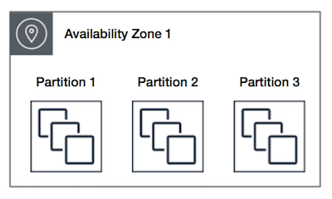
Partition Placement Groups
AWS ensures that each partition within a placement group has its own set of racks.
In the below diagram, there are 3 partition and each partition has multiple EC2 instances.
Each of these partition resides in a different rack inside the Data center.
knowledge portal

Slide 51
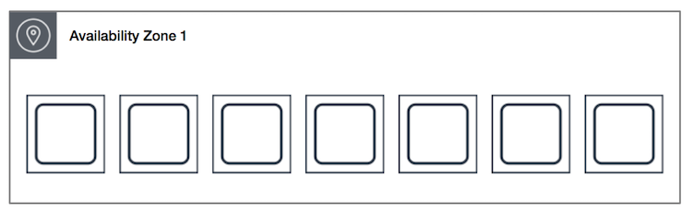
Spread Placement Group
A spread placement group is a group of instances that are each placed on distinct racks, with each rack having its own network and power source.
In the following diagram, there are 7 EC2 instances and each instance is in a separate rack.
knowledge portal

Slide 52
Important Points - Cluster Placement Groups
A cluster placement group can't span multiple Availability Zones.
Only specific types of EC2 instances can be launched.
Maximum network throughput traffic between two instance in placement group is limited by the slower of the two instance.
Recommended to launch all instance together. Launching instance later can lead to capacity errors. In such-case, stop and start all instances in the placement group.
knowledge portal

Slide 53


Join us in our Adventure
kplabs.in/twitter
Be Awesome
kplabs.in/linkedin
instructors@kplabs.in

